Slide 1

Data-Driven Prediction of Ventilation Duration in ICU Patients
Harold Haugen
Alec Pixton
Clarissa Benitez
Emmanuel Leonce

Slide 2

Context/Objective
Predicting Ventilation Duration to Improve ICU Resource Planning
Clinical Relevance: Early prediction of ventilation duration is critical for proactive ICU resource planning and informed patient management decisions.
Problem Framing: We divided our target variable into a binary classification of short-term ventilation (Mod_Under_Day) and long-term ventilation (Sig_Over_Day).
Objective: Develop and evaluate models that predict ventilation duration using pre-ventilation clinical features, enabling early identification of patients likely to require prolonged respiratory support.
Dataset Considerations: The data was stratified into non-invasive and invasive ventilation cases. However, the non-invasive subset was found to be non-representative. Thus, model comparisons focused on invasive cases vs. the full dataset, with the full dataset yielding more robust results.
Notes:
Clarissa

Slide 3

Results
Key Results: The Random Forest model achieved the highest recall of 0.819 and XGBoost came in close second with a recall of 0.811 and demonstrating they effectively identified the severe cases (Sig_Over_Day).
Outcomes: Successfully developed a predictive model for ventilation duration and this included identifying key clinical features that significantly contribute to predicting prolonged ventilation needs.
Key Metrics: Recall was prioritized to ensure the model identifies as many severe cases (Sig_Over_Day) as possible.
In a clinical context, it is safer to capture all potential severe cases, even if it results in more false positives, rather than risk missing critical patients. High recall ensures early identification of at-risk patients, aiding ICU resource allocation and intervention planning.
Notes:
Alec

Slide 4

Results: Main Takeaway
Including non-invasive ventilation improved recall for all models
Model | ROC-AUC | Recall | Specificity | Precision | Accuracy
XGBoost/Full | 0.823 | 0.811 | 0.692 | 0.726 | 0.752
XGBoost/Invasive | 0.821 | 0.803 | 0.708 | 0.738 | 0.756
Random Forest/Full | 0.805 | 0.819 | 0.652 | 0.697 | 0.735
Random Forest/Invasive | 0.811 | 0.785 | 0.682 | 0.710 | 0.733
Logistic Regression/Full | 0.792 | 0.727 | 0.729 | 0.726 | 0.724
Logistic Regression/Invasive | 0.792 | 0.725 | 0.723 | 0.726 | 0.725
Neural Network/Full | 0.796 | 0.754 | 0.703 | 0.713 | 0.728
Neural Network/Invasive | 0.547 | 0.351 | 0.700 | 0.464 | 0.552
Notes:
Alec
Models Tested / Train-Test Split

Slide 5
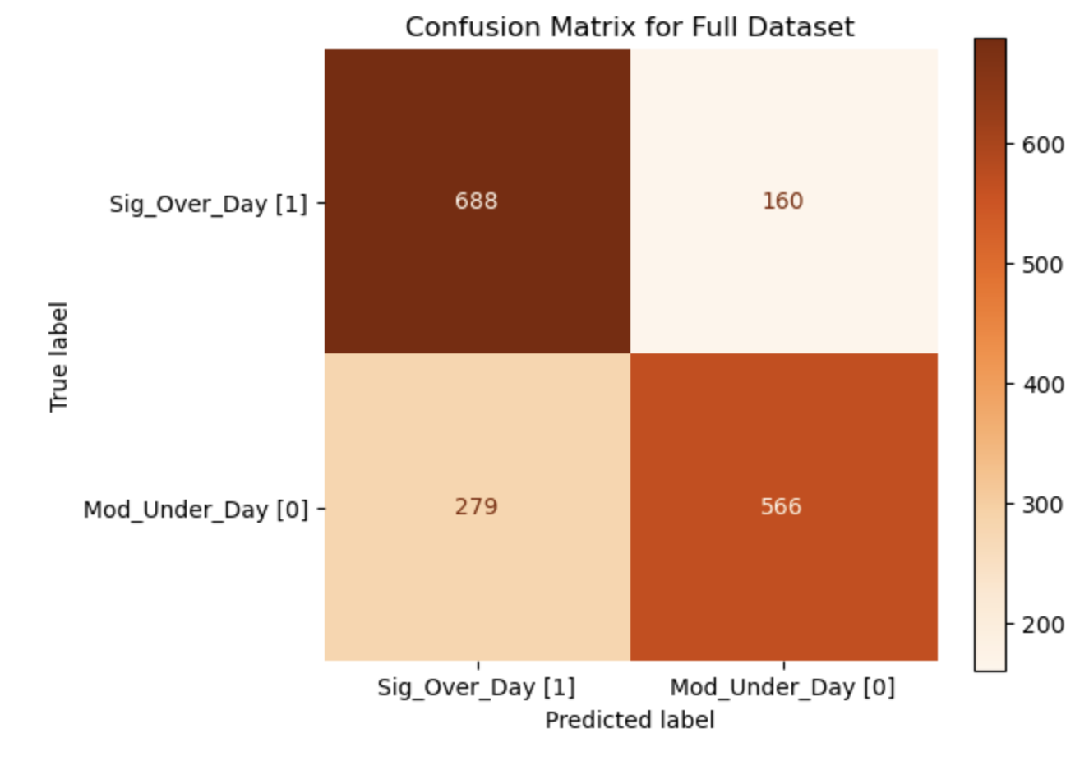
Results: Confusion Matrix
Incorrectly predicting that patients will stay less than a day on a ventilator will cause more stress on the system
Individual
Family
Nurses
Doctors
Hospital Administration
How does one day impact each of these?

Slide 6
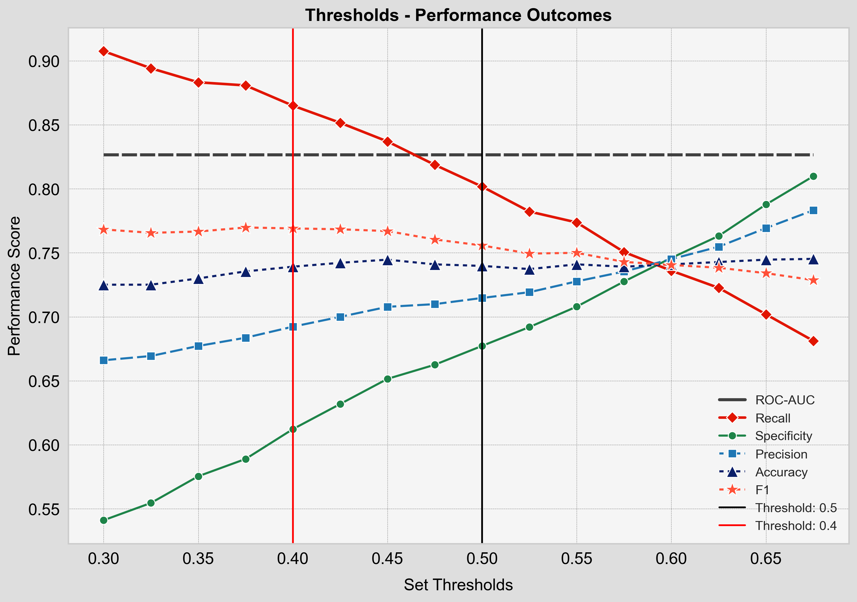
Results: Threshold
Adjusting the threshold can enable higher recall for better applicability
Would you prefer to be unexpectedly released from the hospital sooner than expected or have what was expected to be a short visit turn into a multi-day ordeal?

Slide 7
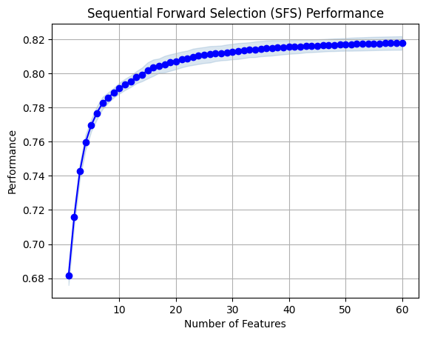
Results: Feature Selection
Increasing the number of included features provides diminishing returns in performance
Full set vs Reduced set
One-hot encoding
Grouped vs Ungrouped
60th iteration took 8.6 min
If this model was deployed real-time, how many variables would we expect to collect from a patient?

Slide 8

Analysis
Feature Importance
EDA
Analysis of Feature Importance will help identify which clinical variables most influence model prediction.
Prioritizes the most relevant features for training
Reduces model complexity
Improves interpretability and computational efficiency
Enhances generalization and clinical relevance
To uncover patterns, evaluate data quality, and identify potentially informative medical features contributing to predictive inference:
Evaluating distributions of clinical data to detect skew, outliers, or group differences
Identifying correlations or interactions between features and outcomes
Forming hypotheses about which variables may hold predictive value
Notes:
For Analysis: we covered this through
EDA
Distribution of Clinical Data
Correlation of Features
Hypothesis
Feature Importance
Interpretability and Understanding
Reduce Model Complexity
Prioritize most Relevant features for Training

Slide 9
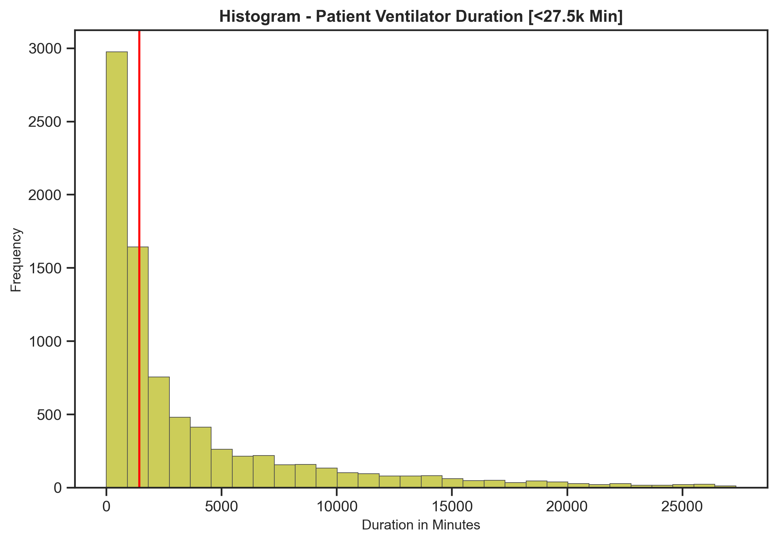
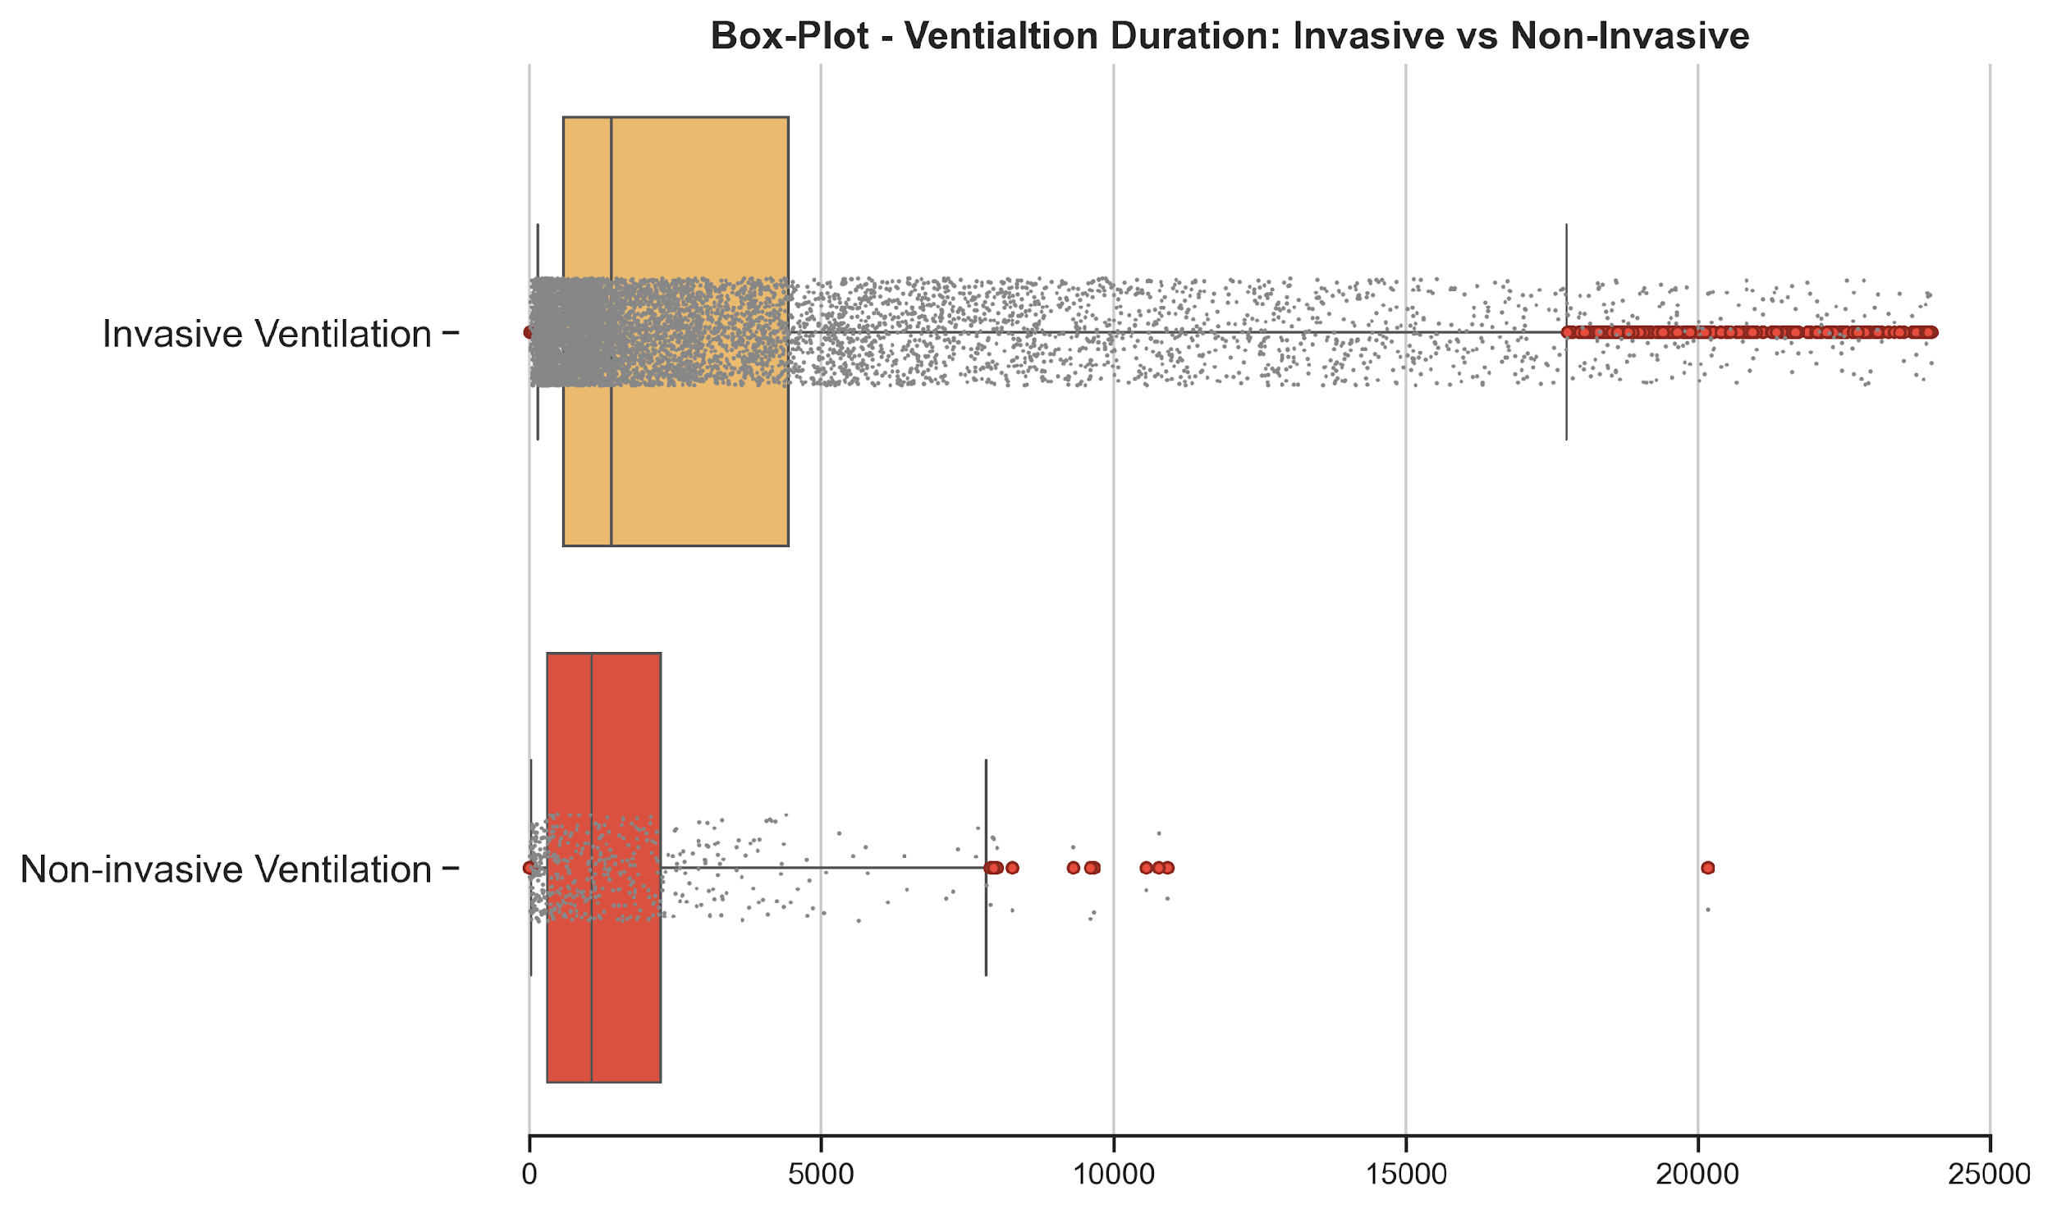
EDA
Confirmed: Skewed but Learnable Distribution for Predictive Modeling
1 Day Threshold
Does the distribution of ventilator duration offer sufficient variance & clinically meaningful signal / spread?
Will the Ventilation Type Label instill leakage into the problem?
Notes:
Sufficient Variance and Meaningful Spread
Review of Histogram [Skewed Right, Good Distribution]
Are there different types of ventilation events?
Review of the Ventilation Type / Outliers @ 2.5%

Slide 10
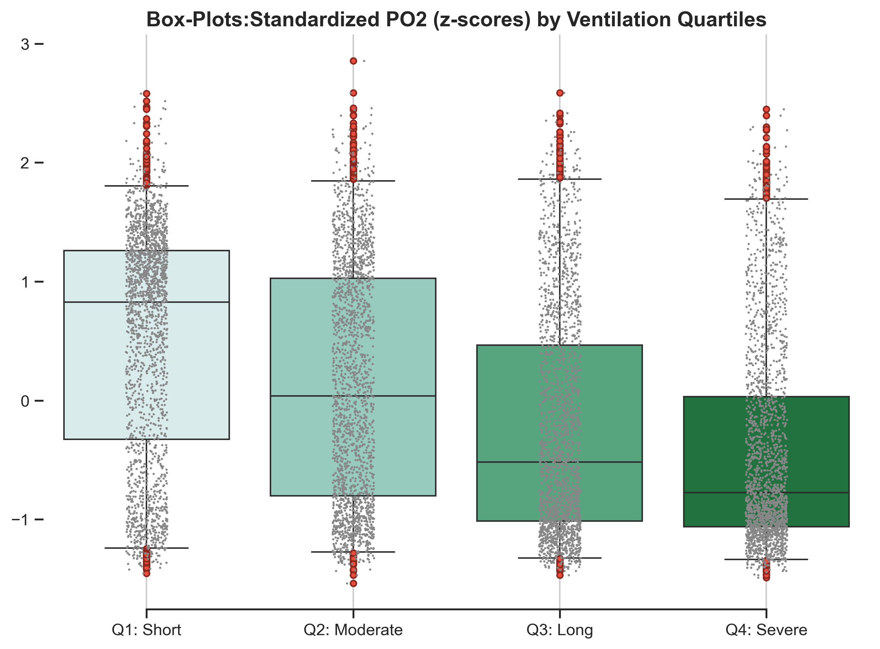
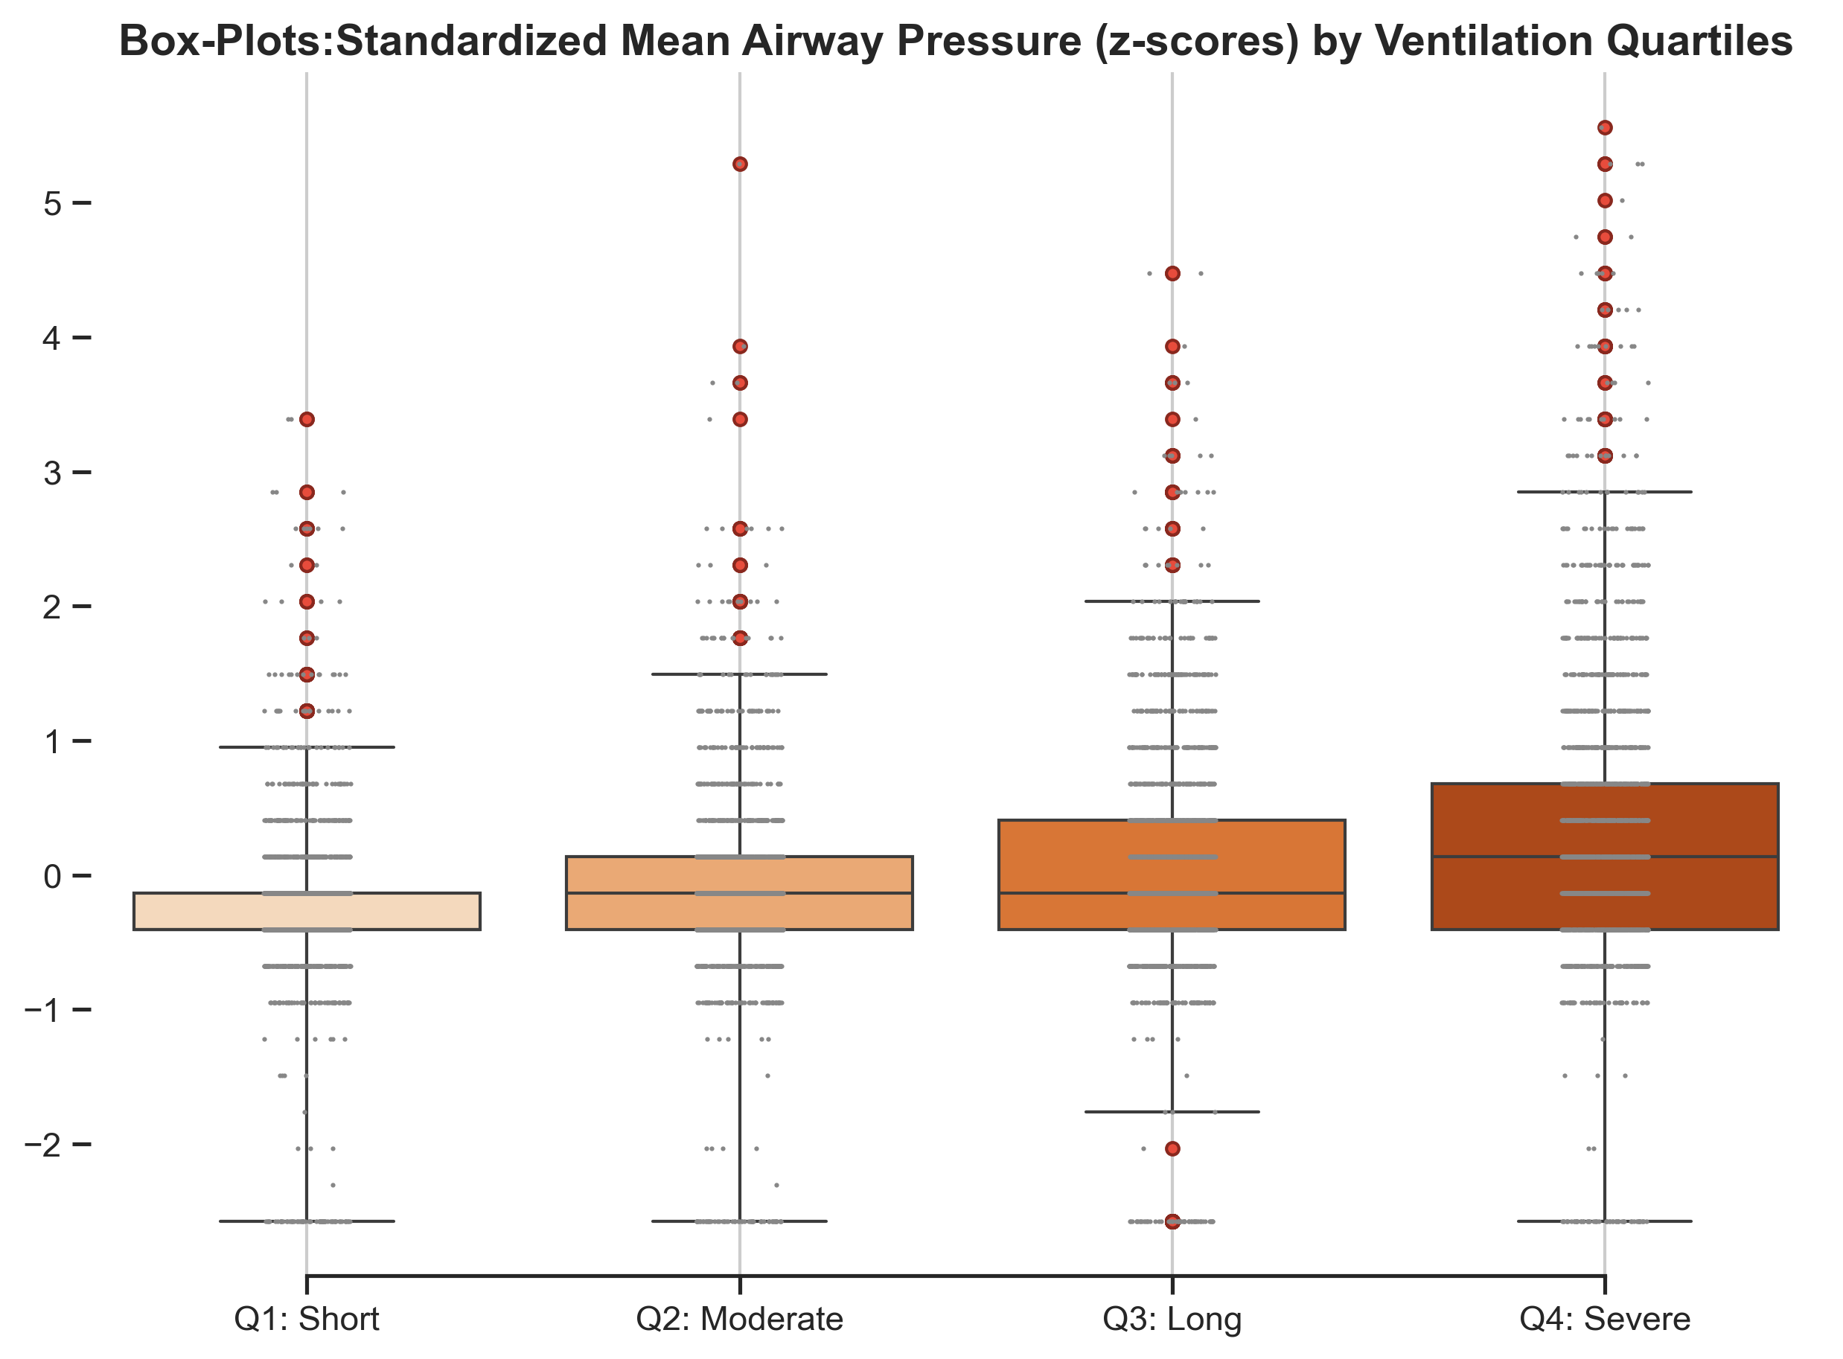
EDA
Multiple Features Show Predictive Patterns, Including PO₂ & Mean Airway Pressure
Duration Severity
Are there Features that meaningfully correlate with the target and Show Predictive Power?
Notes:
Harold
Respiratory Related Lab Events – we found several such as Total PCO2 CO2 gas in blood, Respiratory Rate, O2 Saturation - percentage of hemoglobin binding sites occupied by oxygen
PO2 - PO₂ (Partial Pressure of Oxygen) measures the amount of oxygen gas dissolved in the blood.
Mean Airway Pressure - average pressure in airways during one full respiratory cycle (inspiration + expiration) while on mechanical ventilation.
MAP increases because the patient’s lungs are not adequately oxygenating at lower pressures.

Slide 11
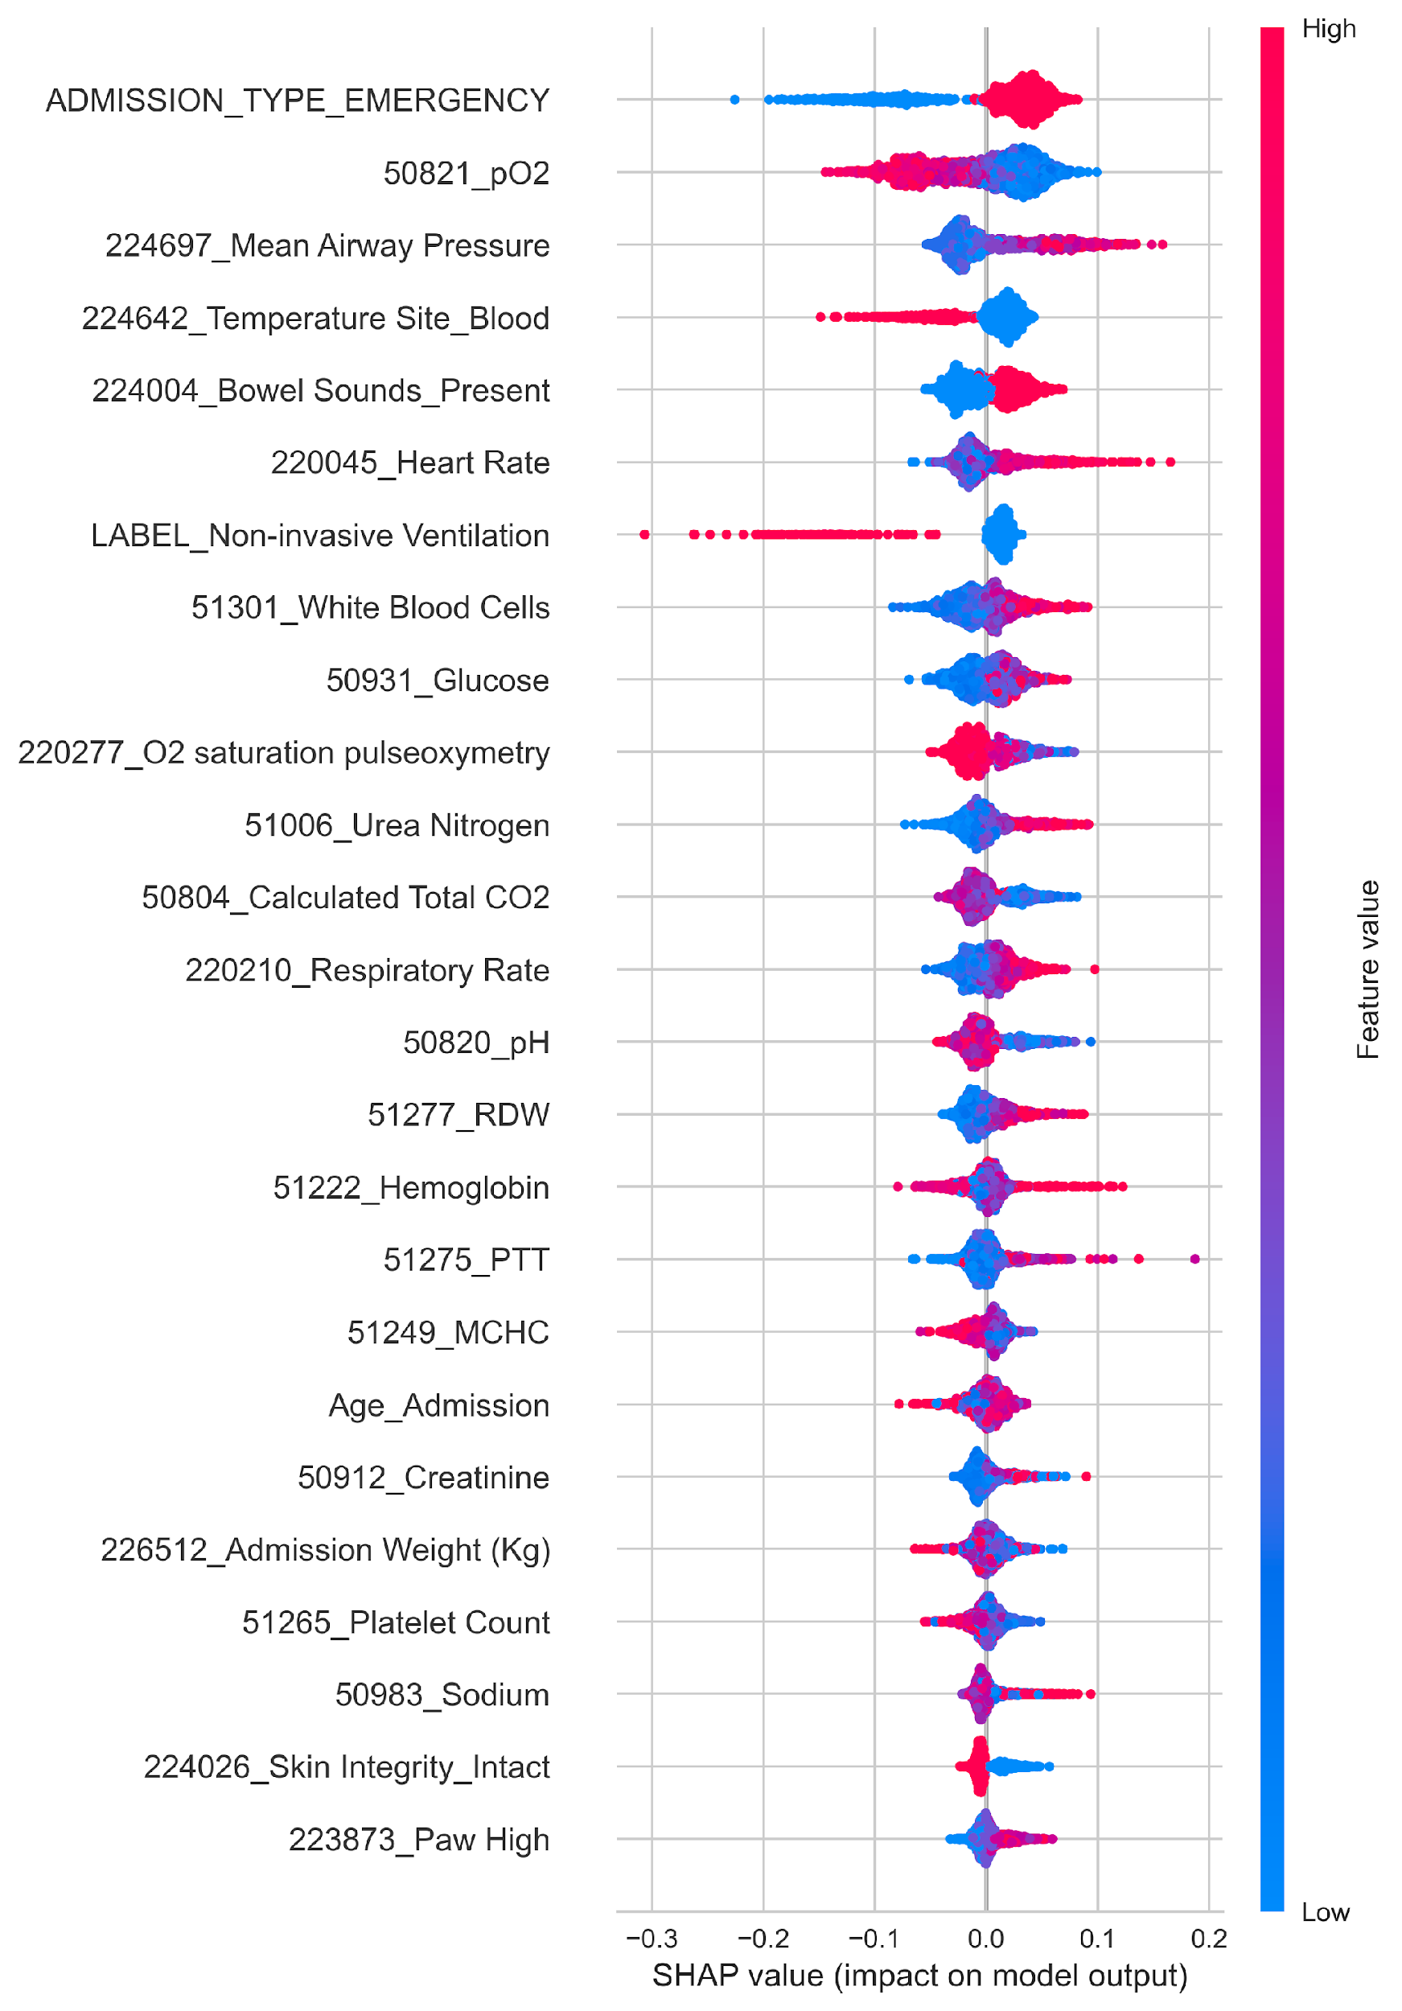
Feature Importance
Core Features Identified - SHAP Importance Scoring
We confirmed that a series of Admission, Laboratory & Patient features meaningfully drive predication.
SHAP Values – Indicate Magnitude / Push Towards Positive Class “> 1 Day Ventilated"
Model Interpretability / Trust and Transparency
Model efficiency – faster model training and lower computational cost w/ fewer features
Enhances feasibility for deployment – by prioritizing a sub-set of inputs, real-time data collection is more practical
Improved Generalization – avoid overfitting by eliminating noisy or irrelevant features
Enhanced Clinical Insight for future research
Notes:
Harold
Describe SHAP visualization:
Colors represent the Raw Values of the Feature
Red – Higher || Blue Lower
Shows the push towards or away from the Positive Class

Slide 12

Data Structure
MIMIC-III Data Schema for Scalable Research
Data Source
Mimic-III Clinical Database
Source – intensive care unit (ICU) of Beth Israel Deaconess Medical Center (2001 to 2012)
Data is de-identified in accordance with HIPPA using data cleaning and date shifting.
DOBs where patient > 89 yrs – Date Shifted
Target Variable
Ventilation Duration [‘VALUE’]
ITEMID 225792 – Invasive Ventilation
ITEMID 225794 – Non-Invasive Ventilation
Features
73 Feature Variables from Tables
Procedure Events
Admissions
Patients
Laboratory Tests
Charted Events / Observations
Notes:
Harold

Slide 13
Data Structure
MIMIC-III Data Schema for Scalable Research
PROCEDUREEVENTS_MV
ROW_ID | 258,066
SUBJECT_ID
HADM_ID
ICUSTAY_ID
STARTTIME
ENDTIME
ITEMID | 12,160
VALUE
** Other
Unique Keys
SUBJECT_ID | 9,329 Unique Events
HADM_ID
ICUSTAY_ID
Ventilation Data Model
ROW_ID | 8,392
FEATURES | 73 | 244 w/ Encoding
D_ITEMS
ROW_ID | 12,487
ITEMID | 12,487
LINKSTO | Tables
LABEL | 11,847 Uniq.
CATEGORY | 95 Uniq.
* Select Features merged for Final Data Model
* Apply Data Assumptions / Cleaning
Research Identified 2 Labels Needed for Extraction
Item IDs 225792 / 94
PATIENT
ROW_ID | 46,520
ADMISSIONS
ROW_ID | 58,976
* ~12k Ventilation Events identified from Procedure Events
LABEVENTS
ROW_ID | 27.85M
CHARTEVENTS
ROW_ID | 330.7M
ICUSTAY
ROW_ID | 8,516
Notes:
Harold
Lab Events – 726 Unique Item IDs
Chart Events – 6,463 Unique Item IDs
Wrangling and Cleaning: Removed 72 records due to >5 ventilation events in HADM, duplicate records, Null Values.

Slide 14
Data Structure
Data Assumptions
Unique Ventilation Events: Defined using SUBJECT_ID and HADM_ID.
For multiple events per HADM, we kept the first hospital day's longest event to ensure clinical relevance and data availability.
First Occurrence Events: Used the earliest lab and chart events per admission to maintain temporal consistency and reduce missing data.
Feature Inclusion Threshold: Independent medical features with more than ~3% missing ventilation Subjects were excluded to reduce noise and improve reliability, ensuring a balance between feature diversity and data completeness.
Representativeness: Assumed that the filtered cohort remains representative of the overall ventilation population, with minimal introduction of bias.
Data Transformation: Standard Scaling and One-Hot Encoding
Notes:
Clarissa

Slide 15
Data Limitations: Dataset limited to MIMIC-III, a single-center ICU database (Beth Israel Deaconess Medical Center).
Data Cleaning: Certain tables held moderate error levels, requiring manual cleaning and approximation.
Feature Exclusion / Missing Subjects: Other potentially interesting features were not prevalent across all Subjects; requiring time for data Imputation.
Generalizability: Since the data is from a single medical center and is de-identified, the findings may not apply to other healthcare systems.
Limitations
Notes:
Clarissa / Harold

Slide 16

List what the possible recommendations or next steps would be
Next Steps
Incorporate Time-Series Data: Evolve from single-day snapshots to models that track patient condition over time, enabling dynamic, longitudinal predictions.
Enable Cross-System Compatibility: Adapt the model to work with diverse hospital EHR systems and data schemas for broader adoption.
Embed Model into Clinical Workflow: Integrate predictions into triage and resource planning processes to support real-time clinical decision-making.
Notes:
Emmanuel

Slide 17

Summary Recap
Early prediction of ventilation duration is critical for optimizing ICU resource allocation and improving patient care strategies.
We developed a Random Forest model that classifies patients at risk of prolonged ventilation using clinical data available prior to intubation. The model achieved a recall of 0.819, effectively identifying severe cases.
A key strength of the model is its reliance on routinely collected clinical measurements, such as pO2, Mean Airway Pressure, and Heart Rate, which are already recorded in real-time upon patient admission. This minimizes the need for additional testing, allowing the model to be seamlessly applied within existing clinical workflows.
Notes:
Clarissa

Slide 18

Questions?

